Slide 1
Branch and Bound Method
Assignment 7
2025/07/10
HUANG Jiahui, 44251017
Notes:
Good evening. Today I’m presenting Assignment 7 about Branch-and-Bound method, which aims to find optimal solutions by smartly exploring the search space.

Slide 2
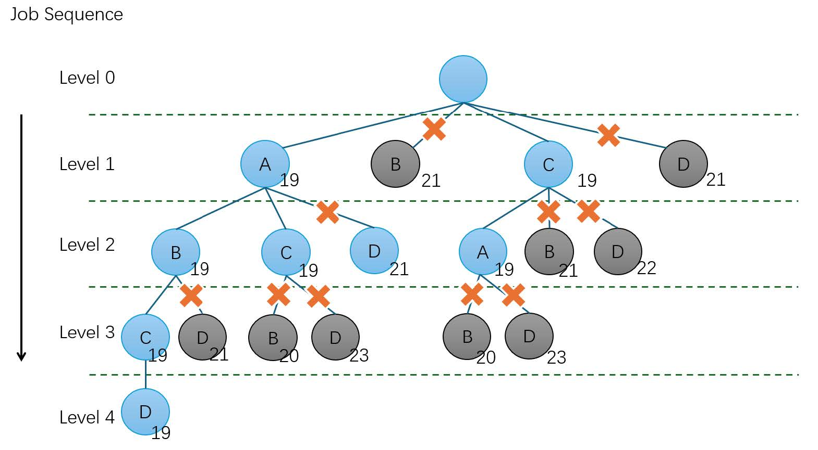
Why I Chose Branch-and-Bound
Optimality
Branch and Bound guarantees optimality in solutions for problems that satisfy certain conditions, ensuring that the best possible solution is found.
Memory Efficiency
It typically requires less memory compared to other exhaustive search methods, especially for problems with large search spaces.
Flexibility
It's adaptable to various problem domains and can accommodate different problem representations and constraints.
Easy to visualize with search trees
The method builds a tree structure that shows all decision paths, which is helpful for debugging and explanation.
Notes:
I chose Branch and Bound because it offers several strong advantages.
First, it guarantees optimality by systematically checking all possibilities while pruning unpromising ones.
Second, it’s memory-efficient for large search spaces.
Third, it's very flexible and can be adapted to different types of scheduling problems.
Finally, its tree structure makes the logic easy to visualize and debug.

Slide 3
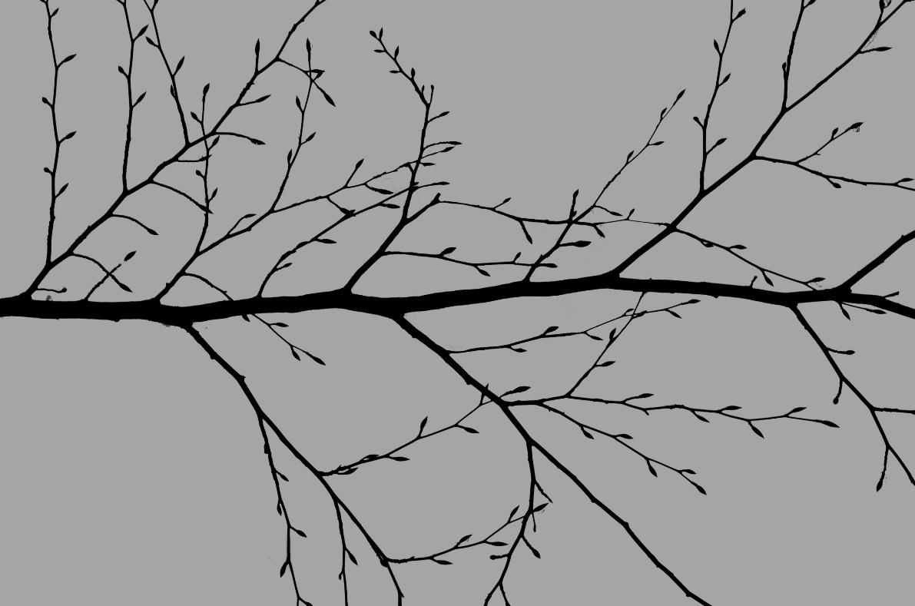
Difficulties in Application
Lower bound = maximum value for all operation stages = (
Latest Ending time of the operations on the operation stage of the scheduled jobs +
Total processing time of the operations on the operation stage of the unscheduled jobs +
Minimum value of the total processing time of the operations remaining after the operation stage for each job)
Search tree grows fast
The tree will become larger and larger as the number of jobs increases.
High computation for large problems
Even with pruning, the number of nodes to explore can be large. It takes time and memory.
Lower bounds are complex to compute
Finding good lower bounds involves estimating the remaining best-case processing time across multiple machines.
Hard to manage partial solutions
Need to track machine states, job progress, and precedence for every node in the tree.
Notes:
Despite its strengths, Branch and Bound has some difficulties.
As the number of jobs increases, the search tree grows very fast, which leads to high computational costs.
Also, calculating accurate lower bounds is difficult and time-consuming.
Managing all the states of machines and partially scheduled jobs can also be complex and error-prone.

Slide 4
How to Improve
Improving the Lower Bound Quality
For large-scale problems, the single most important improvement is enhancing the lower bound calculation to make it as "tight" as possible. A tighter lower bound will be higher, thus allowing the algorithm to prune more branches earlier in the search process. This directly combats the combinatorial explosion of the solution space by making the pruning process more aggressive and efficient.
Best-First Search and Priority Rules
Instead of exploring nodes in a random or breadth-first order, a best-first search strategy should be used. This means always expanding the node with the lowest current lower bound, as it has the highest chance of leading to an optimal solution. In addition, introducing priority rules (e.g., critical path first, highest workload next) can help the algorithm focus on more promising regions of the search space.
Hybrid Methods with Metaheuristics
To balance exactness and speed, branch-and-bound can be combined with heuristic/metaheuristic methods, such as:
Genetic algorithms: for global exploration of promising regions
Simulated annealing or tabu search: for local optimization around good solutions
Local search: to refine near-optimal solutions before or during the branch-and-bound process
Notes:
To apply this method to large real-world problems, some improvements are needed. First, improving the quality of the lower bound is critical. A tighter bound means more pruning and faster search. Second, using best-first search and priority rules helps focus on the most promising branches. Third, we can parallelize the process and explore multiple branches at the same time. Finally, combining this method with metaheuristics like genetic algorithms or local search improves both speed and solution quality.
最后：These hybrid approaches allow the algorithm to quickly find high-quality solutions and then focus the exact branch-and-bound process on only the most promising subspaces.

Slide 5
Thank You
Notes:
Thank you very much for listening.

Slide 6
Future work
There are something we need to do in the future
Using the description of the DBpedia ontology Tree
Design a better way to select hierarchy information
Finetune the LLM2Vec with the knowledge graph data
Ablation Analysis on Different Hierarchical Information
Notes:
In future work, we plan to enhance the model by incorporating DBpedia ontology descriptions directly into the embeddings, improving candidate search accuracy. We will also refine the selection of CaLiGraph hierarchy information, moving away from random selection to a more targeted approach that optimizes embeddings. Additionally, we aim to fine-tune the LLM2Vec model using CaLiGraph and DBpedia data to better tailor it for the specific task of ontology mapping. Finally, we will conduct an ablation study to assess the impact of different hierarchy information types on model performance, helping us identify the most valuable inputs for accurate results.

